Slide 1
Sample Project for CSCI 434/534
Department of Computer Science
College of William and Mary

Slide 2


Objective
Monitoring and Analyzing computer network traffic, particularly from popular internet websites such as Google, Facebook, and YouTube.
Extracting features from website traffic data and build models to classify the specific website from which the traffic originated.
The classification is done automatically, without access to the website URL or data payload that is typically encrypted.
Figure source: https://hellofuture.orange.com/en/encrypting-or-classifying-internet-traffic-do-we-have-to-choose/
Notes:
Inner product

Slide 3

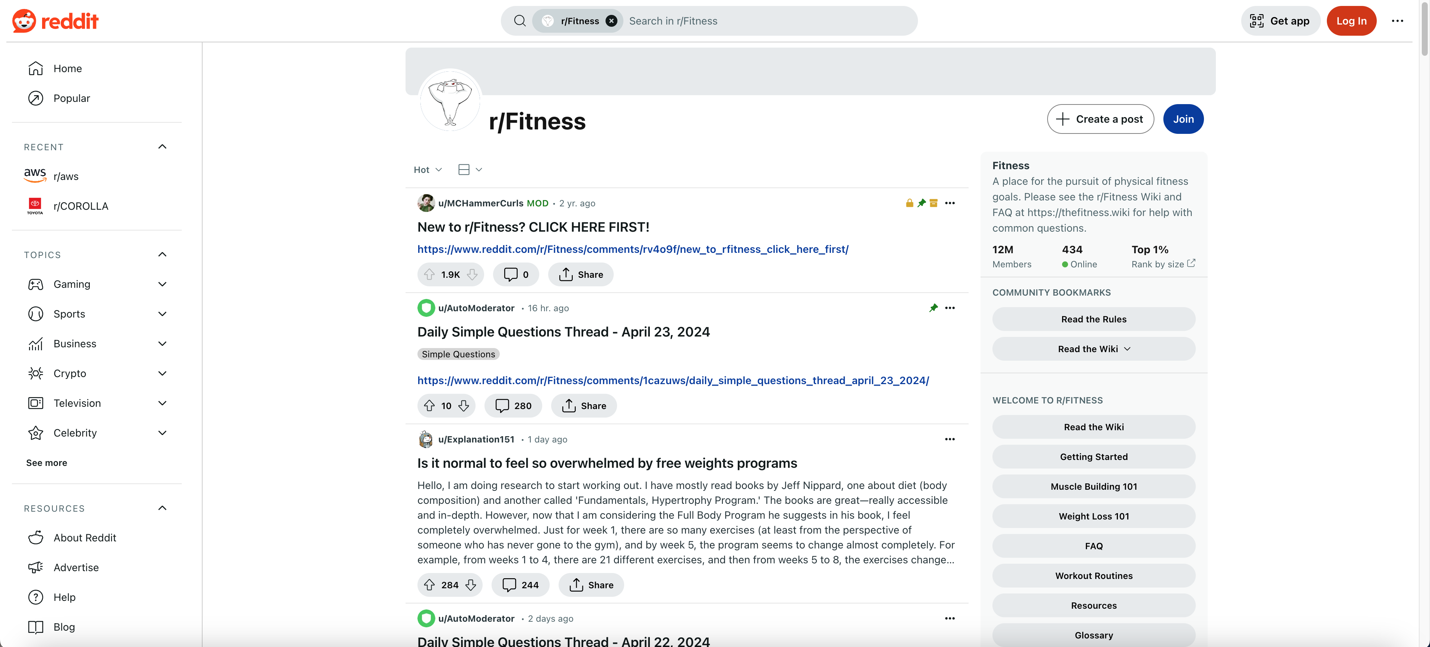
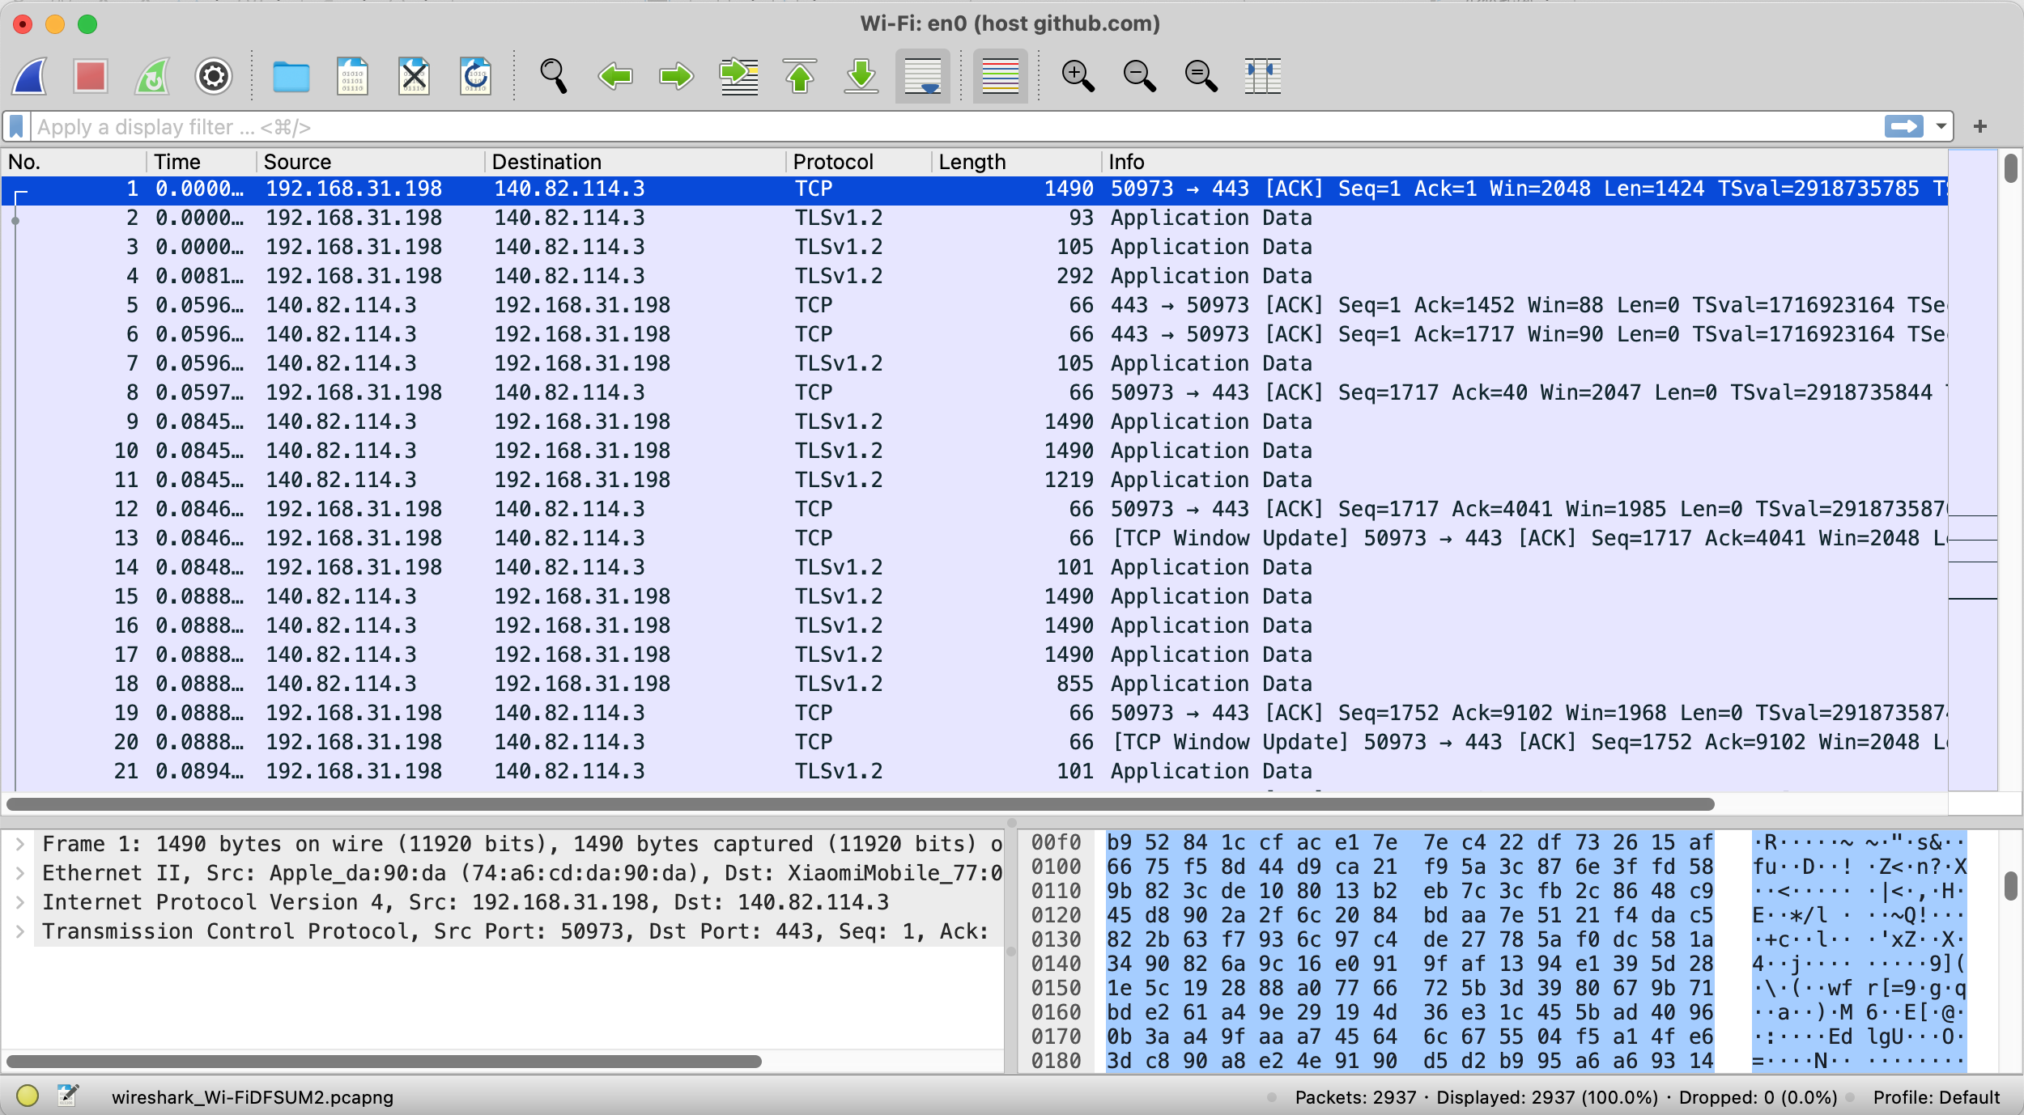
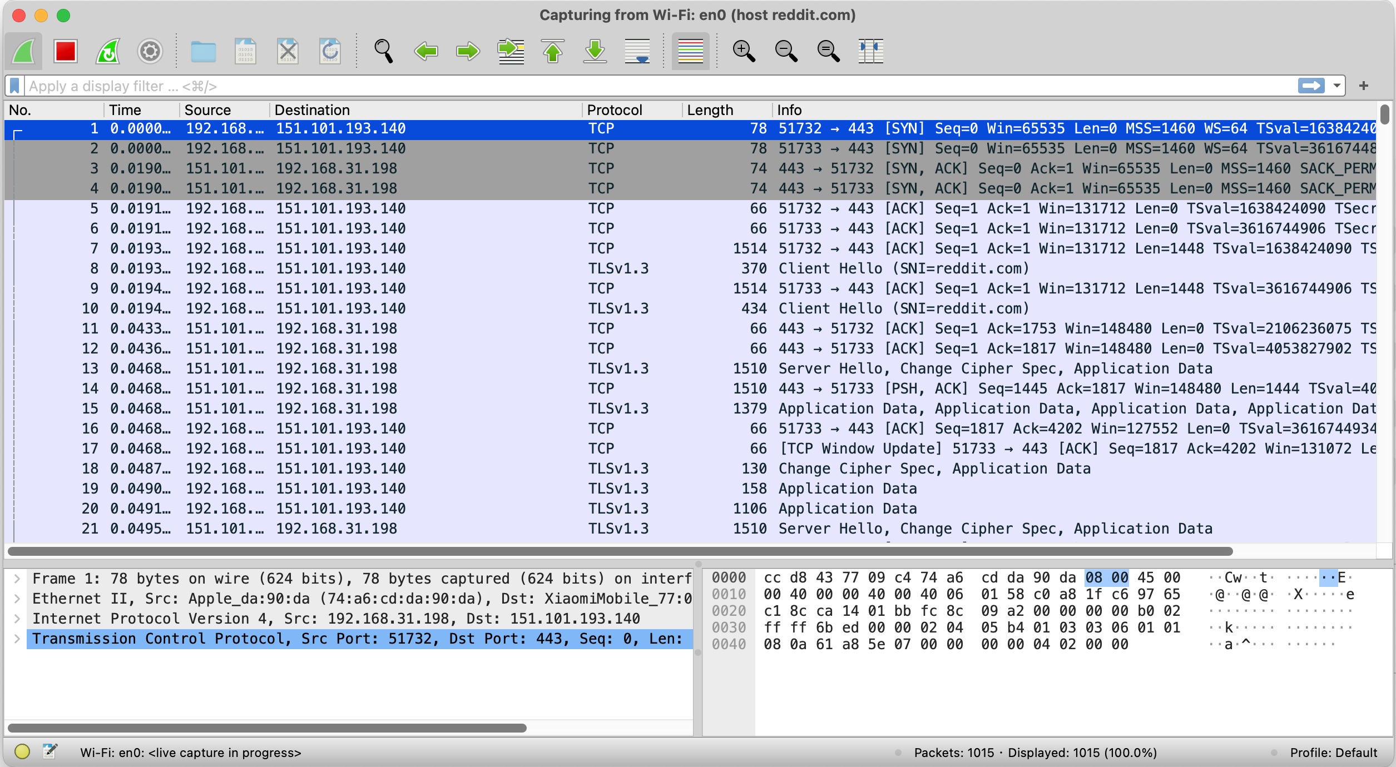
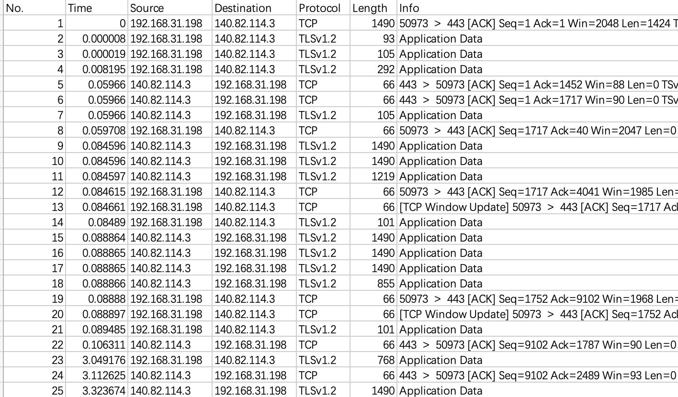
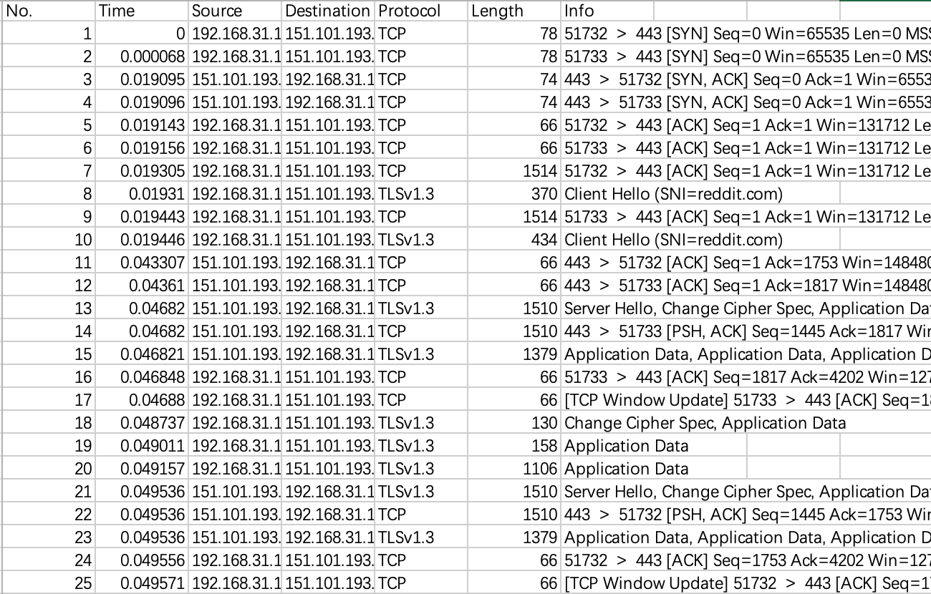
Data Collection
GitHub
Reddit
Visited Website
Wireshark Collected Data
LinkedIn
Instagram
Weather
…
Exported Data
Notes:
Inner product

Slide 4
Dataset Details
Dataset Size
Dataset Samples
Label | Size
GitHub | 2,938
Instagram | 1,168
LinkedIn | 2,092
Reddit | 1,015
Weather | 1,445
Total | 8,658
Protocol | Length | Label
TCP | 1490 | GitHub
TLSv1.2 | 105 | GitHub
TCP | 66 | GitHub
UDP | 1182 | Instagram
UDP | 378 | Instagram
UDP | 1274 | Instagram
TCP | 54 | LinkedIn
TLSv1.2 | 892 | LinkedIn
TCP | 78 | Reddit
TCP | 66 | Reddit
TCP | 1514 | Reddit
TCP | 74 | Weather
TCP | 78 | Weather
TCP | 74 | Weather
… | … | …
Extracted Features
Features | Details
Protocol | This field in the packet header specifies the protocol used for the communication. The protocol determines how data is formatted, transmitted, and processed. It essentially informs the receiving system on how to interpret the packet‘s data payload. E.g., TCP, UDP, TLSv1.3…
Length | The Length field of a packet specifies the total size of the packet, including the header and the data payload. This is crucial for both the segmentation and reassembly processes during data transmission.
Notes:
Inner product

Slide 5
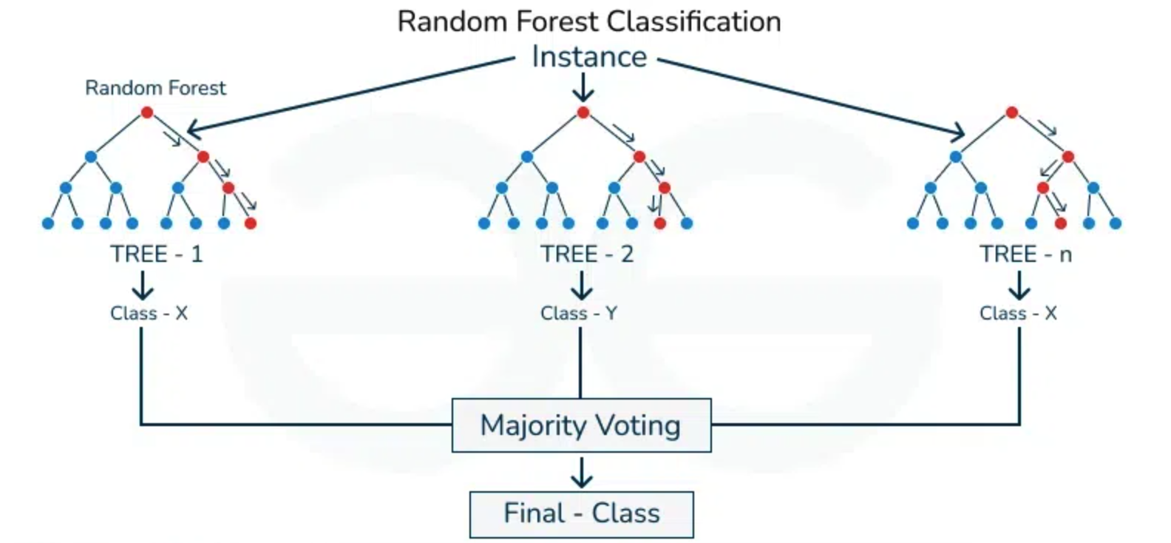
Model – Random Forest
Definition: Random Forest is an ensemble learning method used for classification and regression. It builds multiple decision trees and merges them together to get a more accurate and stable prediction.
How It Works:
Bootstrap Aggregating: Randomly selects samples from the data set to build multiple decision trees.
Feature Randomness: At each split during the construction of a tree, a random subset of features is considered.
Majority Voting (Classification) / Averaging (Regression): Each tree makes a prediction. The mode (classification) or mean (regression) of these predictions is taken as the result to improve accuracy and control over-fitting.
Baselines:
Linear Regression
Logistic Regression
Figure Source: https://www.geeksforgeeks.org/random-forest-classifier-using-scikit-learn/
Notes:
Inner product

Slide 6
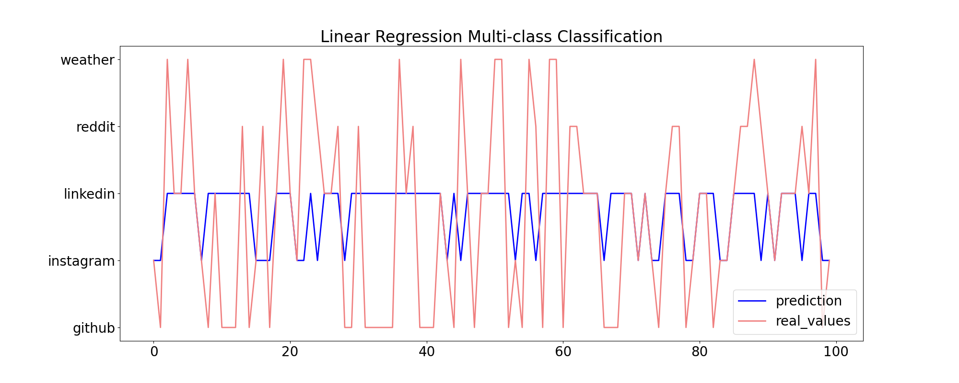
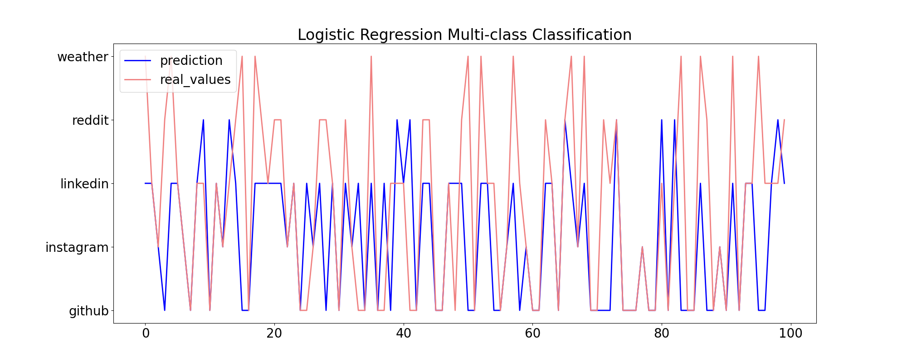
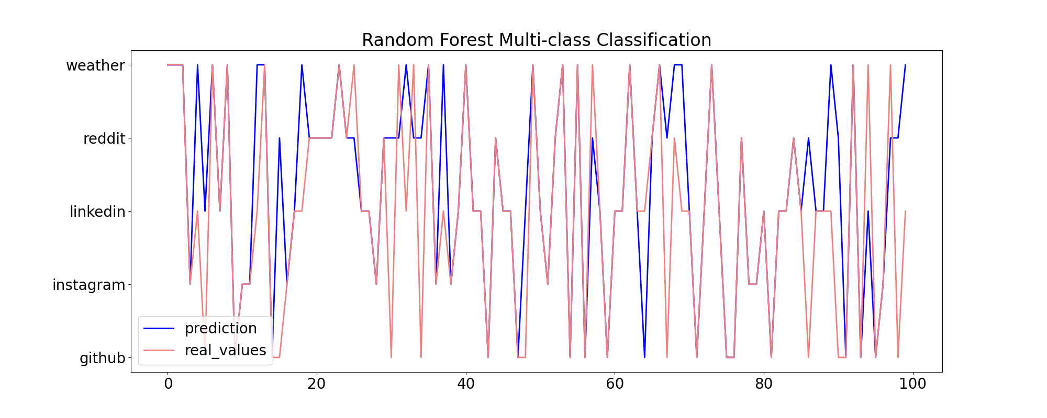
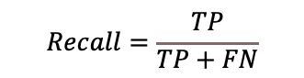
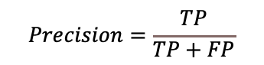
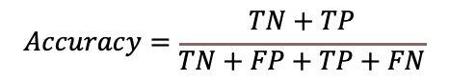
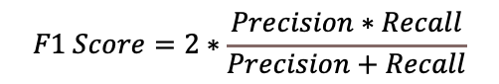
Result
Evaluation Results (Train/Validation/Test: 6:2:2)
Linear Regression
Model | Accuracy | Marco F1 Score
Linear Regression | 0.37 | 0.22
Logistic Regression | 0.56 | 0.47
Random Forest | 0.83 | 0.82
Logistic Regression
Model Performance: Achieved an accuracy of 0.83 and a macro F1 score of 0.82, significantly outperforming baseline models (Linear Regression and Logistic Regression).
Visual Analysis of 100 Samples: Demonstrates that Random Forest predictions closely align with actual values, unlike the large discrepancies observed in Linear Regression and Logistic Regression predictions.
Random Forest
$$Precision=\frac{TP}{TP+FP}$$
$$Recall=\frac{TP}{TP+FN}$$
$$Accuracy=\frac{TN+TP}{TN+FP+TP+FN}$$
$$F1 Score=2∗\frac{Precision∗Recall}{Precision+Recall}$$
Note: TP = True positive; FP = False positive; TN = True negative; FN = False negative.
Notes:
Inner product

